Slide 1
​
TNWISE2025
HACKATHON FOR WOMEN IN SCIENCE & ENGINEERING
THEME:TRANSPORTATION & MOBILITY
TITLE:DRONE LOGISTICS
COLLEGE:SUGUNA COLLEGE OF ENGINEERING

Slide 2
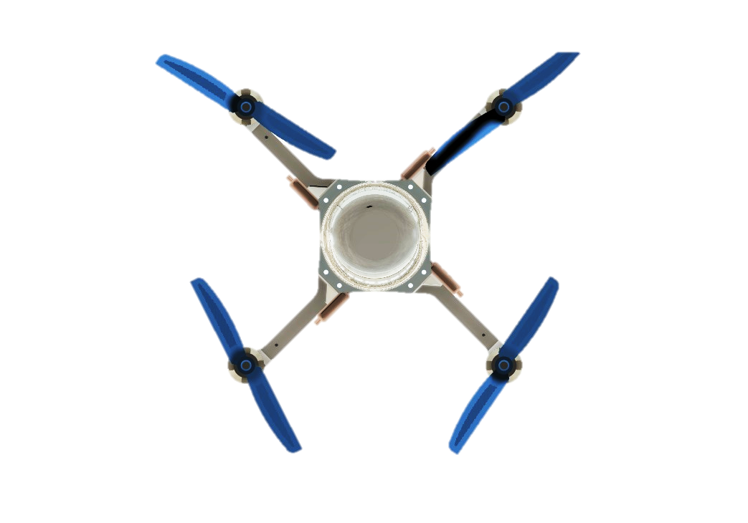
Introduction
Drone logistics refers to the use of unmanned aerial vehicles (UAVs) for transporting goods efficiently.
In the medical field, drones are used to deliver essential supplies such as blood, vaccines, organs, and emergency medicines.

Slide 3
Problem statement
Current challenges include traffic, geographical barriers, and logistical inefficiencies.
Delays due to traffic in urban areas.
Limited access to remote or disaster-affected areas.
High transportation costs and dependency on road networks.
Time-sensitive medical emergencies (e.g., blood, organs, vaccines).

Slide 4
Objective of the work
To design and implement a fast, reliable, and autonomous medical supply delivery system using drones.
To reduce delivery time in emergency situations such as accidents, disaster relief, and remote area healthcare.
To enhance the efficiency of medical logistics, particularly in inaccessible or congested areas.

Slide 5
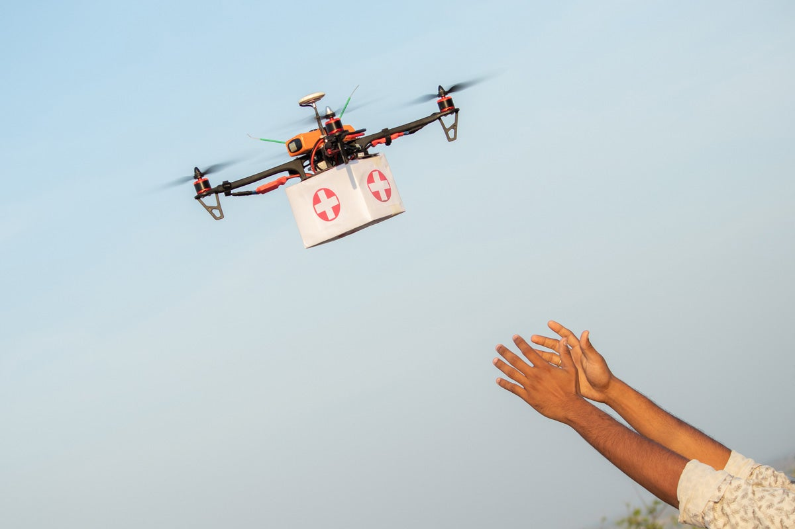
How it works
A hospital or emergency site requests medical supplies.
The nearest available drone is deployed with the required payload.
The drone autonomously navigates to the delivery location.
The supplies are safely dropped off or retrieved.
The drone returns to its base for recharging and the next mission.

Slide 6
Future Implementation
AI-Powered Autonomous Drones :Self-navigation, avoiding obstacles and optimizing flight paths.
Advanced Battery and Power System: Use of hydrogen fuel cells to enhance drone efficiency and range.
Weather-Resistant and All-Terrain Drone: Rugged drone designs will allow operation in extreme weather conditions (storms, heavy rain, high winds).
Integration with Smart Hospitals & Emergency Response Systems: Drones will be automatically dispatched based on hospital requests and patient needs.

Slide 7
Conclusion
Drone logistics is a game-changer in medical supply delivery, especially in emergencies.
Overcomes time delays, accessibility issues, and logistical barriers.
Future advancements in AI, battery technology, and regulations will make drone delivery mainstream.
A step towards a smarter, faster, and more efficient healthcare system.

